Slide 1
Board Briefing Template
Purpose:
This template is for use by the enterprise cybersecurity executive, to prepare, gather, format and present a comprehensive update briefing on the state of the enterprise cybersecurity program
Format:
The format follows that proscribed by the National Association of Corporate Directors (NACD) for reporting cybersecurity matters to the Board of Directors
Content:
Content includes NIST-compliant metrics and key indicators, allowing board members to understand the cybersecurity program, including optional strategies and tradeoffs, in business terms
Process:
The template is to be used as a high-level structure including a four-part process flow outline. Assemble updated graphs, charts and other content. Include key metrics and analyses specifically focusing on strategic trade-offs, options under evaluation, and relevance to top business strategies
ThrivacaTM in Action

Slide 2
W E L C O M E
Board of Directors - Cybersecurity Briefing
“Boards should have adequate access to cybersecurity expertise, and discussions about cyber-risk management should be given regular and adequate time on the board meeting agenda.”
- National Association of Corporate Directors (NACD)

Slide 3

The National Association of Corporate Directors (NACD) recommends key themes for boards and senior management to consider when addressing cybersecurity risk:
Building a coherent and strategic cybersecurity program, not just a series of point solutions
Cybersecurity governance measures as a priority
Insight into vital cybersecurity decisions
Ongoing adjustments being made to reflect the expanding scope of cybersecurity

Slide 4
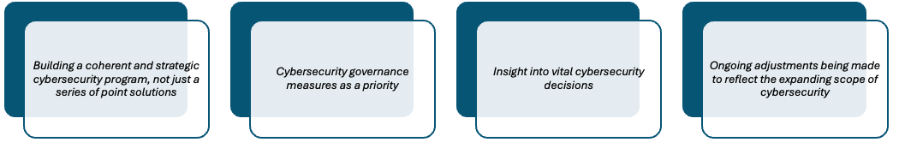
ThrivacaTM in Action

Slide 5
SBOM
AIBOM
Optimization
Nation-state readiness
Business <==> Tech integration
Quantum preparedness
Our Coherent and Strategic
Cybersecurity Program
2020s
Risks
ThrivacaTM in Action
2025+
Digital Twin
Capabilities
Organization
Cybersecurity Exposure
Will - Investment - Action
2000s
Residual Exposure
2010s
Vulnerabilities
Issues - Compliance - Loss
Threats
Analysis ==> Directed Action
Actuarial loss analysis
47,000 known vuln-threat pairings
Scaled to enterprise
Industry-specific pattern data
NIST-approved

Slide 6
Our methods
ThrivacaTM in Action
Comprehensive risk analysis across all the digital areas of exposure across the organization
Properly analyzing the data using actuarial models
Adherence to commonly accepted frameworks (i.e. NIST)
A common, financially quantified foundation for leadership to
Participation in critical decisions

Slide 7
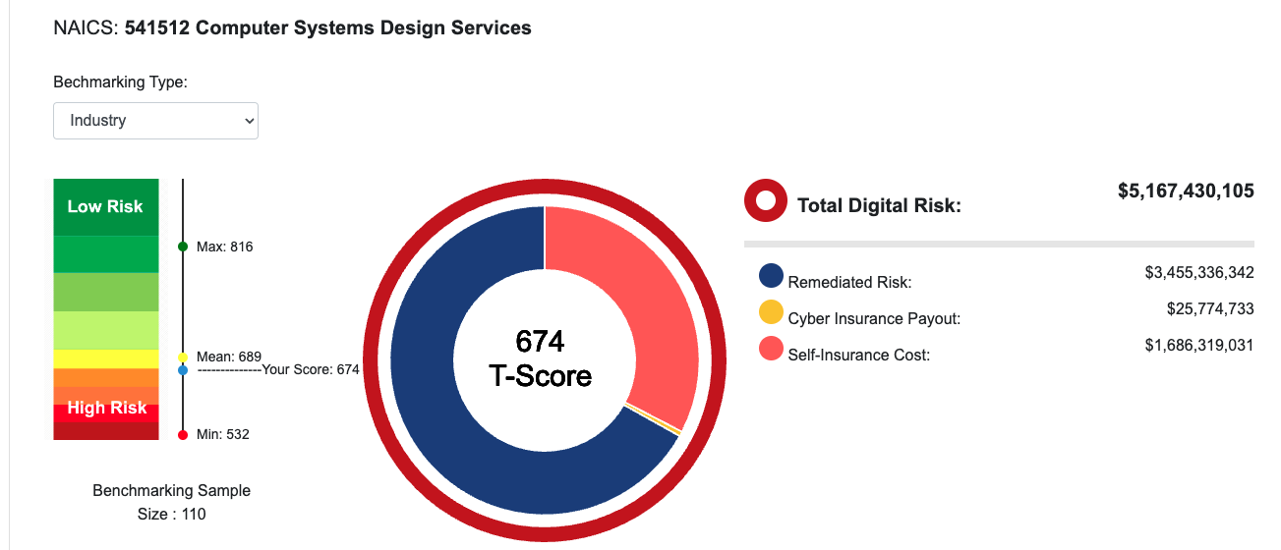
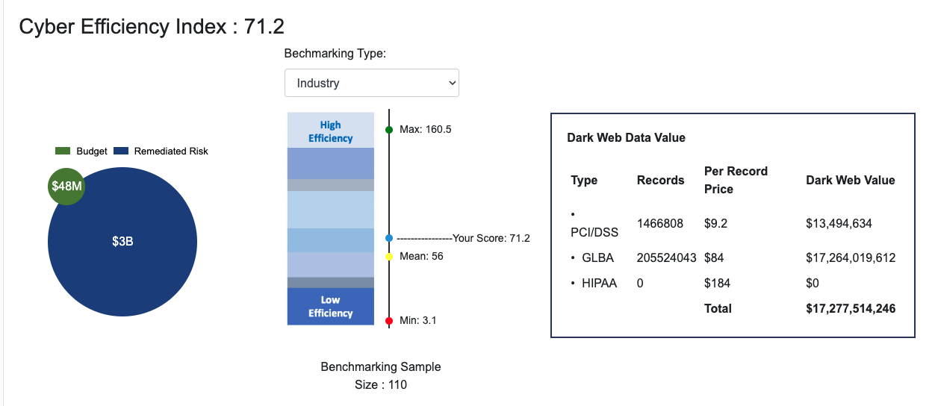
ThrivacaTM in Action
We track our overall status in terms of Risk and Financial Exposure, and compare ourselves to dozens of our industry peers
Replace with your results
Next, we analyze the efficiency of our overall cybersecurity efforts, and measure what we’re spending versus the value of risk reduction results from the same efforts.
We then compare ourselves to our industry peers, and evaluate the value and magnitude of the data we protect.
Replace with your results

Slide 8
ThrivacaTM in Action

Slide 9
Our NIST-proscribed Governance Measures
ThrivacaTM in Action
Cybersecurity Strategy
Cybersecurity Policy
Capabilities Roadmap
Target Operating Model
Cybersecurity Incident Response Plan (CSIRP)
Effective organizational checks and balances
Clear and transparent communication of cybersecurity conditions and status to senior management and the board
Cybersecurity Governance informed by actuarial-science based risk visibility and regulator-mandated remediation plans

Slide 10
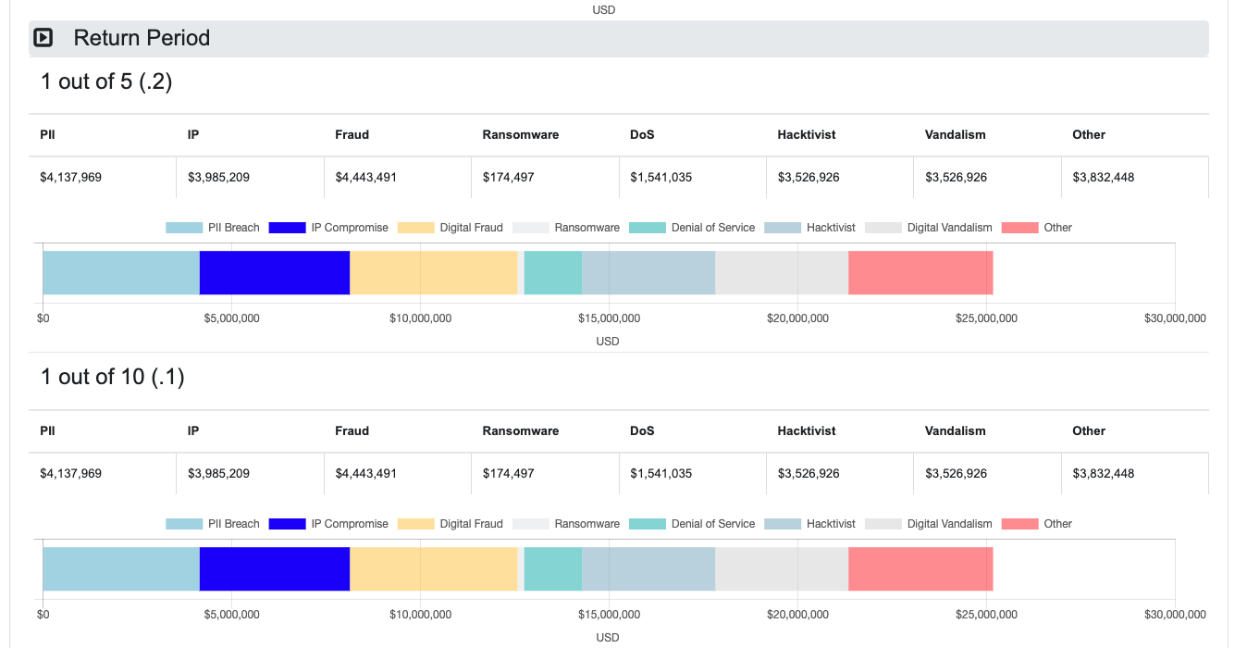
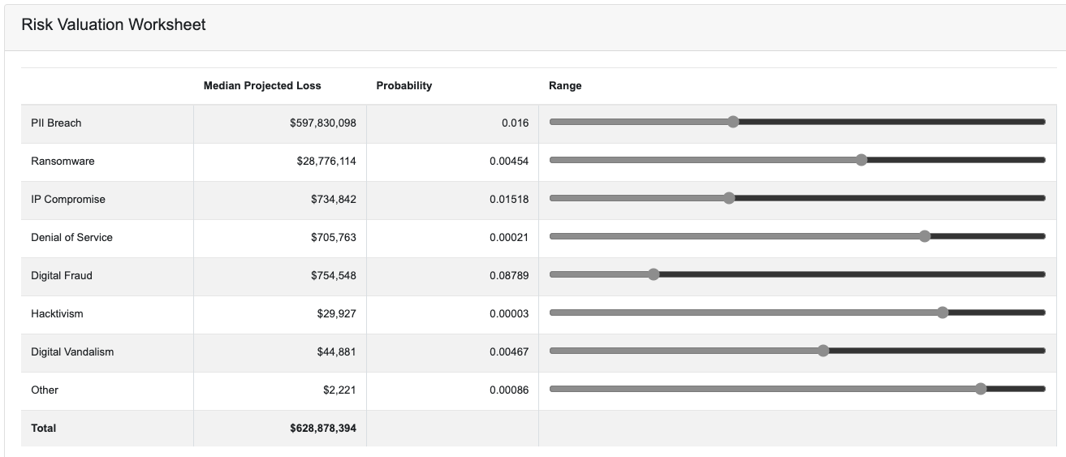
ThrivacaTM in Action
We track our overall risk forecast and potential for loss using actuarial methods to properly evaluate probability across eight major risk types
We show an unremediated loss exposure of <$$$> over the coming 5-year period, and <$$$> over 10 years
Replace with your results
We then adjust our own potential for risk exposure in accordance with leadership’s risk tolerance parameters, and use data from actual losses, our own cybersecurity controls status (according to NIST), and our organization’s financials, to determine our own risk dynamics in business/financial terms
Our current cyber initiatives are targeting a risk tolerance of <$$$>
Replace with your results

Slide 11
ThrivacaTM in Action

Slide 12
Vital Insights
ThrivacaTM in Action
Trade-offs and options for the direction and strategies of cybersecurity
An informative set of facts that are meaningful in terms of costs, risks, financial impact, capital and expense effects of various choices
A common valuation model for the cybersecurity program and its’ results
Put these options into terms that the board can see and understand
Relate cybersecurity to other key decisions such as plant expansion, legal settlements, workforce decisions, acquisitions, etc.

Slide 13
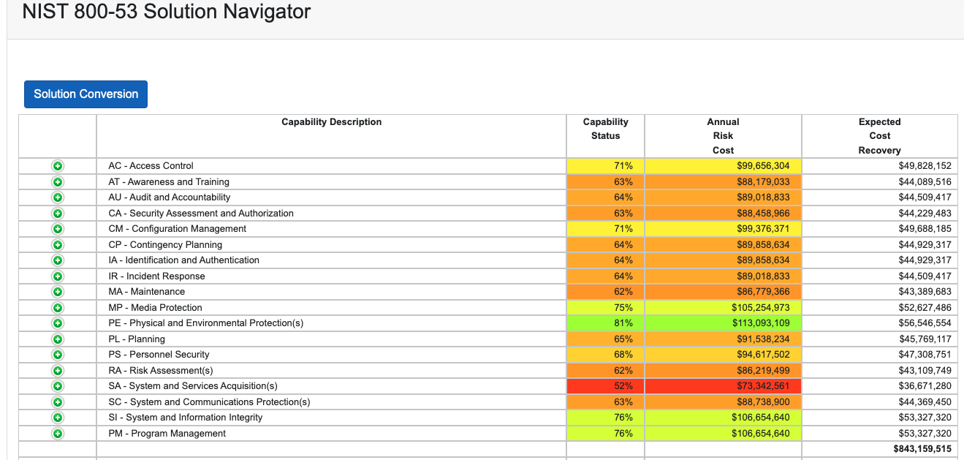
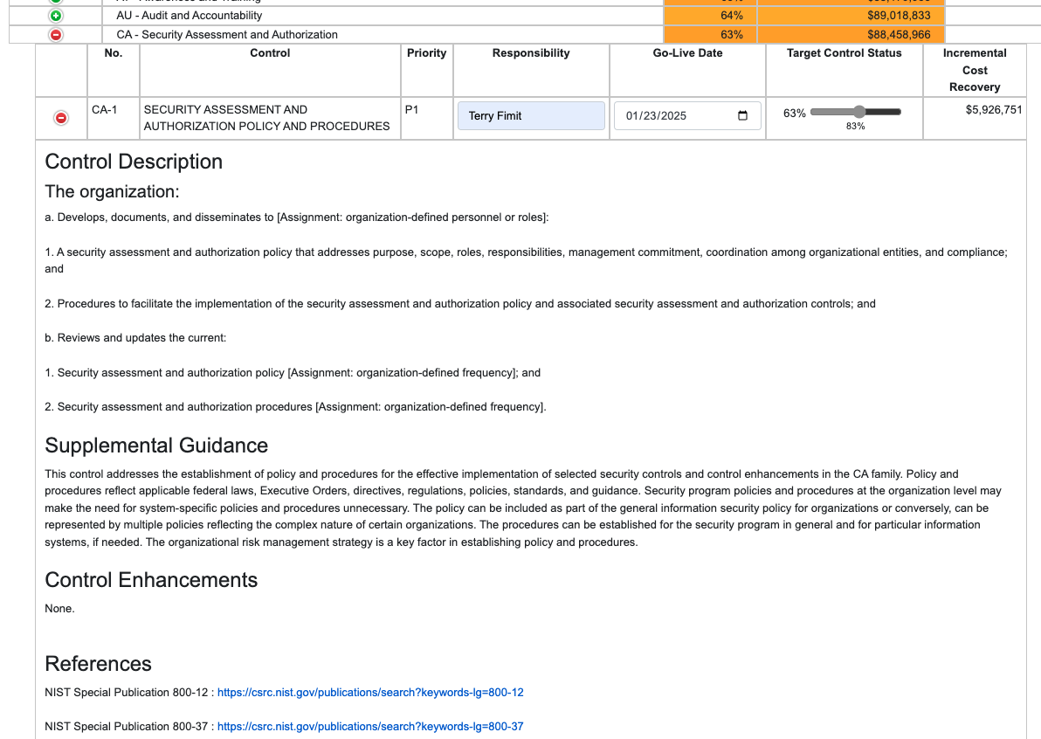
We conduct ongoing evaluations of our current controls status through independent data scans, and plotting those results against NIST frameworks, we identify the areas for greatest improvement and cost recovery
Current Self-Insurance Cost is <$$$>, with <$$> targeted for remediation by year-end
ThrivacaTM in Action
Replace with your results
We then identify the most attractive and feasible tradeoffs and options, and follow federally-approved remediation playbooks, evaluate strategies and solutions, and ultimately assign deliverables to internal and external resources as part of our cybersecurity roadmap
We currently have <XX> initiatives in flight, with another <XX> planned for next quarter
Replace with your results

Slide 14
ThrivacaTM in Action

Slide 15
ThrivacaTM in Action
Almost all key strategies end up with critical cybersecurity considerations that
must be incorporated as early as possible, given the cycle time it takes to build out
these vital security measures.

Slide 16
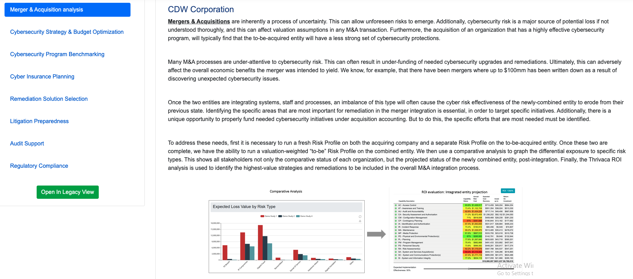
We utilize digital-twin analysis of our present cyber program, to stress-test specific scenarios and use cases under consideration for the business
We then can forecast needed adjustments to cyber strategy and tactics, and the cost takeout associated with each option, allowing management review and approval
ThrivacaTM in Action
Replace with your results
Strategic Initiative | Incremental Risk Exposure | Cost Takeout
XYZ Corp Acquisition
Q2 Cloud Migration
Digital transformation
Latin American Expansion
Replace with your content
Current Initiatives, remediation requirements, and cost takeout forecasted

Slide 17
T H A N K Y O U
Board of Directors - Cybersecurity Briefing
“Boards should have adequate access to cybersecurity expertise, and discussions about cyber-risk management should be given regular and adequate time on the board meeting agenda.”
- National Association of Corporate Directors (NACD)

Slide 18



Did you find this resource helpful? Share your success with us!
Web: ArxNimbus.com
Email: info@arxnimbus.com
Toll-free: 888-422-6584
Follow us for more insights
on cybersecurity risk management.
#ACRQ: It’s not magic, it’s math!

